Slide 1

PERFUME DATABASE MANAGEMENT SYSTEM
Presented by Genevieve Awa
HTTP 5126 - Database Design & Development
Humber Polytechnic - North | Fall 2024

Slide 2

REAL-WORLD SCENARIO
As a database manager hired by a retail perfume company to manage their database system, which tracks brands, products, fragrance notes, retail availability, sales, and related information. You will ensure seamless product updates and provide tools for inventory management, sales analysis, and marketing decisions.

Slide 3

PROBLEMS & DB SOLUTIONS
Problem:
Product Inventory Management
Maintain accurate product, brand, and retail data with efficient updates.
Automate logging of inventory changes for traceability.
Problem:
Fragrance and Sales Analysis:
Simplify access to fragrance profiles and sales trends for data driven decision making.
Solution:
Stored procedure for adding/updating products, brands, fragrance notes, and retail data.
Triggers for logging product name changes in the audit_log table.
Solution:
Views for simplified access to fragrance profiles and sales trends.
Functions for calculating revenue and profitability.
Notes:
problem
-- Keeping product, brand, and store details up-to-date can be messy, especially when there are frequent changes like new products or updates. It’s important to make this process easier and ensure any changes are tracked for future reference
solution
-- A stored procedure automates the process of adding or updating product details, saving time and reducing errors. A trigger logs any product name changes automatically, keeping a history of updates for accountability and easy tracking.

Slide 4
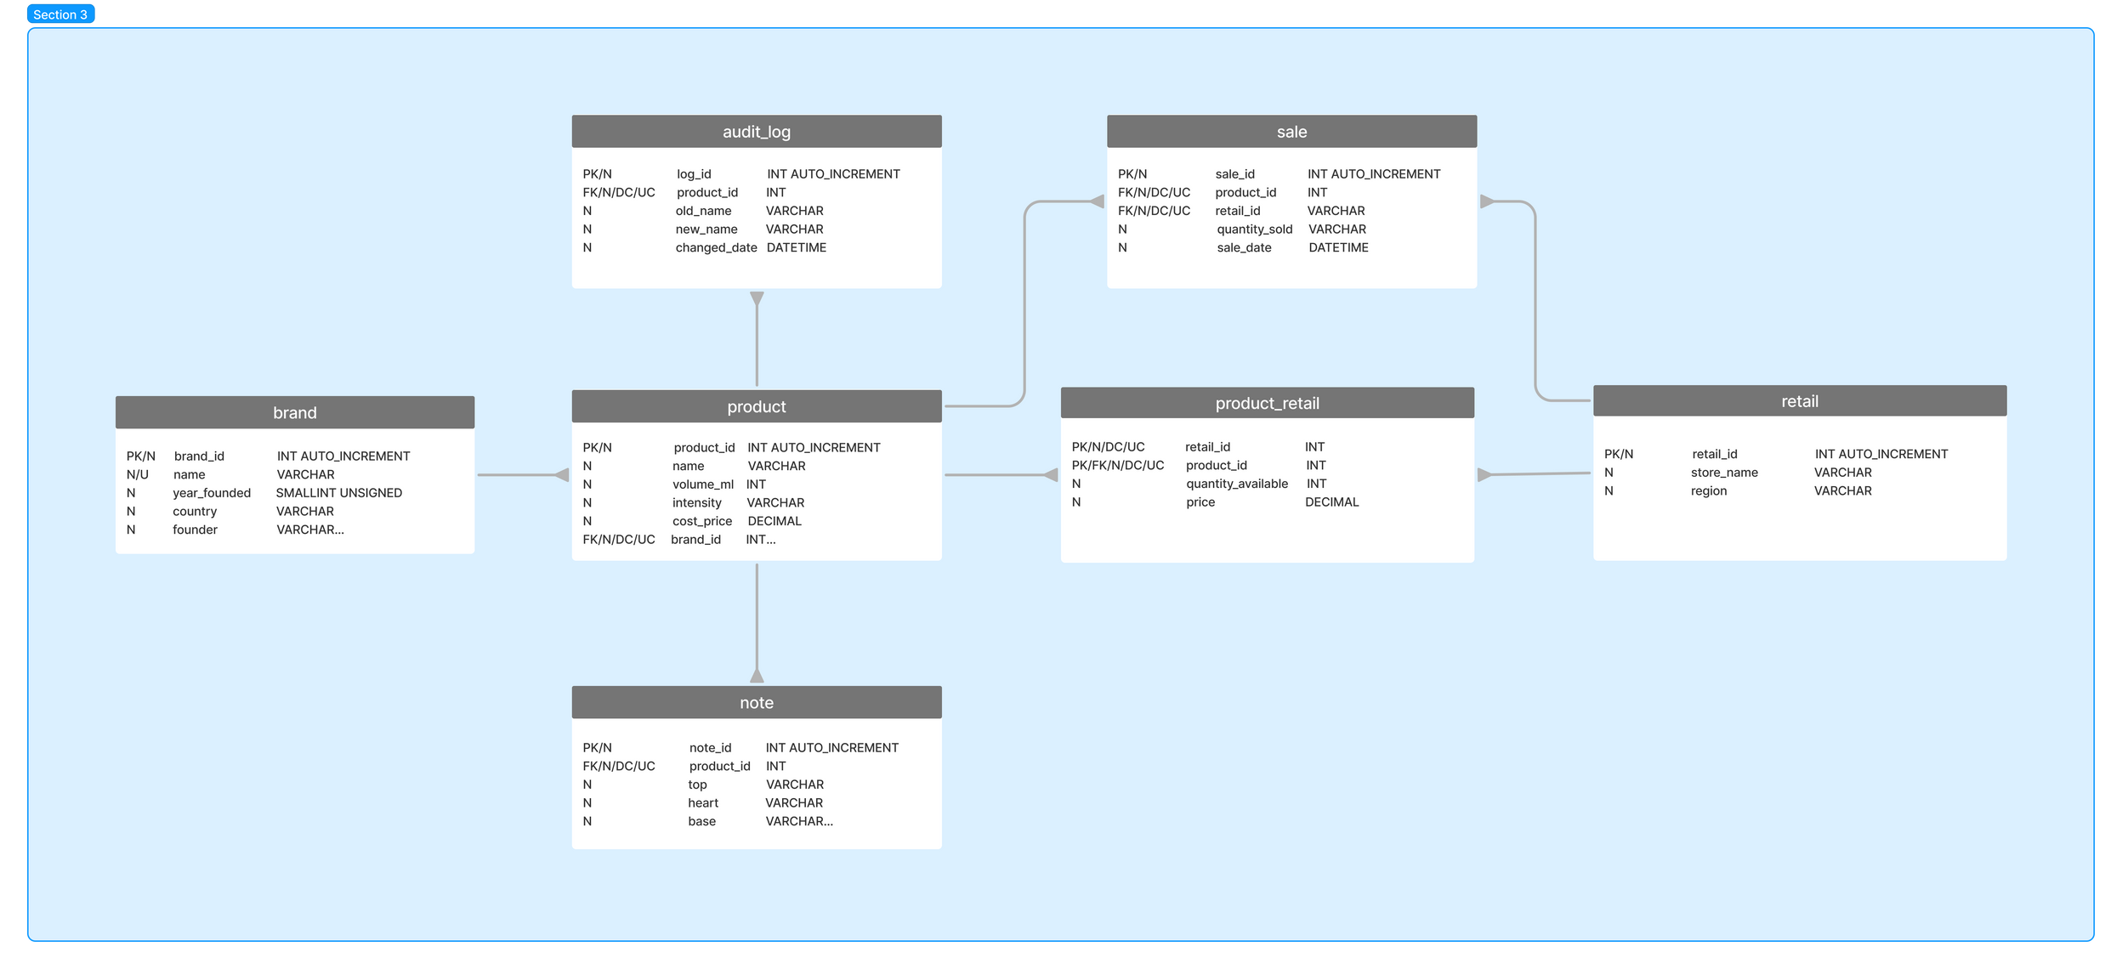
ENTITY RELATIONSHIP DIAGRAM (ERD)

Slide 5
KEY FEATURES IN THE DATABASE
Feature 1: Stored Procedure (usp_add_product_brand_note_retail)
Feature 2: Trigger (trg_product_update)
Feature 3: View (fragrance_profile_view)
Feature 4: Function (fn_get_total_profit)

Slide 6
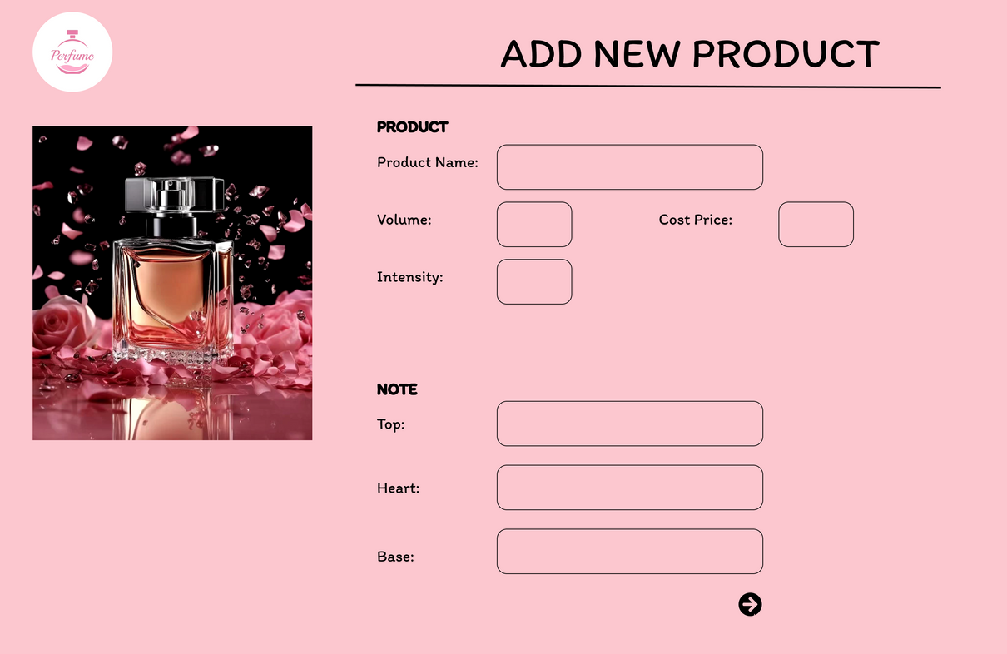
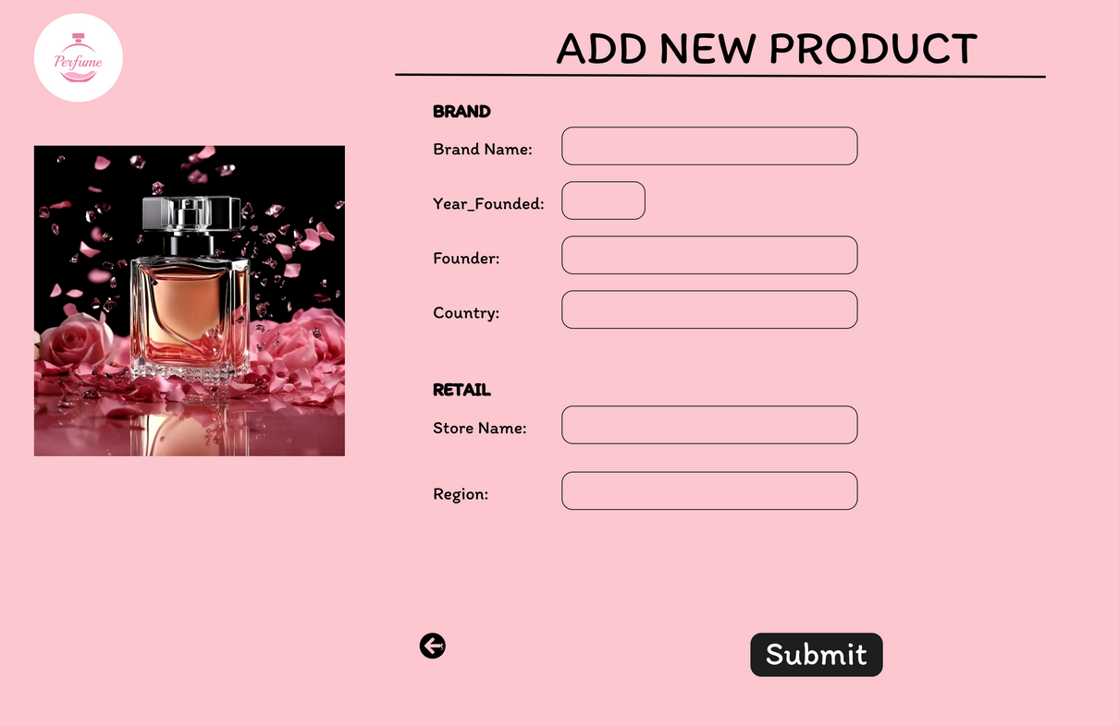
WIREFRAME

Slide 7
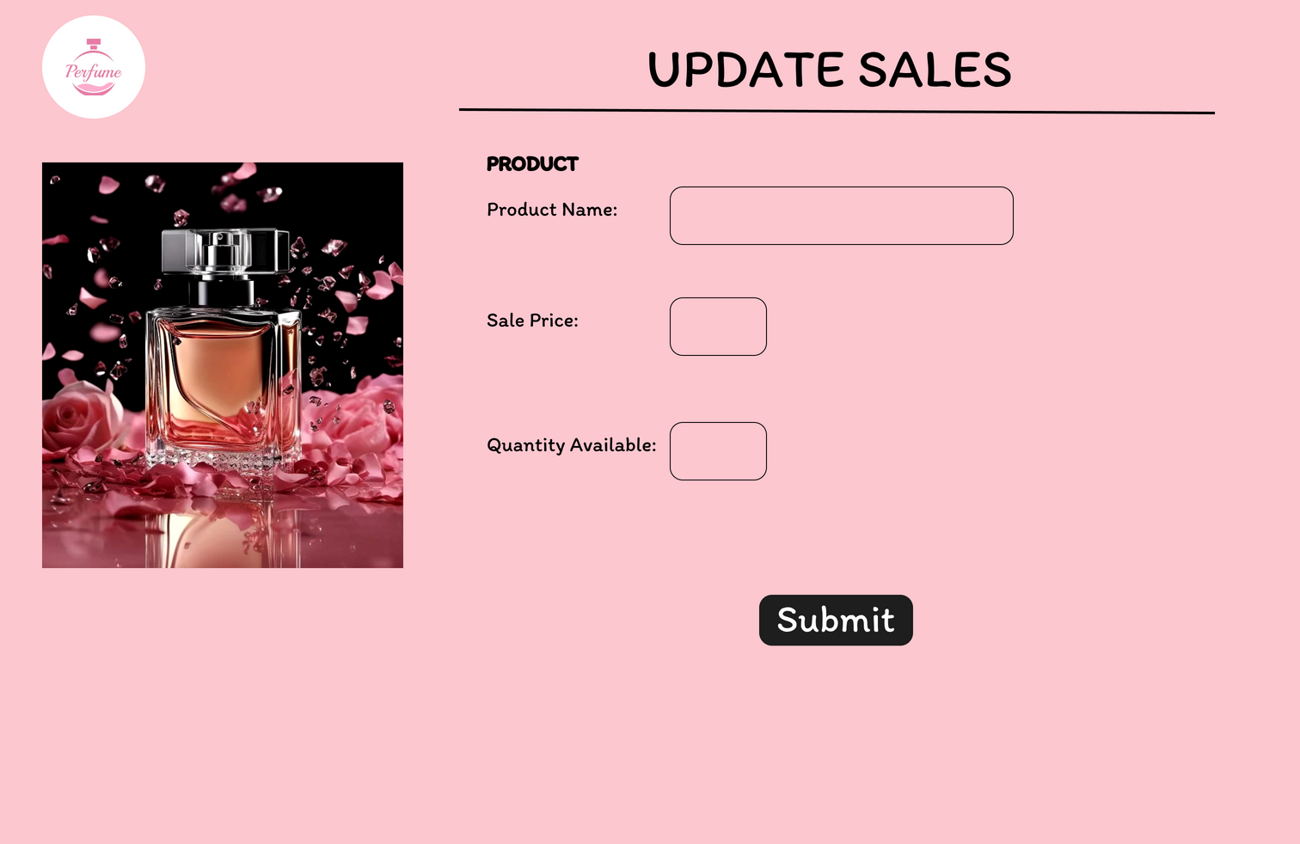
WIREFRAME

Slide 8
THANK YOU

